Slide 1
Predictive Analytics for Airbnb Prices
Simao Chen (Alice), Jiani Lyu, Chelsea Liu, Siyu Miao, Yuewei Shi, Yajie Zeng
CUSP-GX 7023 Applied Data Science
05/05/2024

Slide 2

Overview
Background：
Sharing economy growth, with Airbnb reshaping urban accommodation.
Complex factors influencing pricing, challenging for hosts and guests.
Research Significance：
Helps hosts optimize prices for better occupancy and profitability.
Assists guests in finding cost-effective travel options.
Goals：
Uncover economic trends affecting Airbnb pricing.
Support market participants with data analysis.
Research question:
What factors contribute most significantly to the variation in Airbnb room prices across different neighborhoods, and how accurately can these prices be predicted based on neighborhood and room features?
Introduction
Notes:
Research question intro

Slide 3
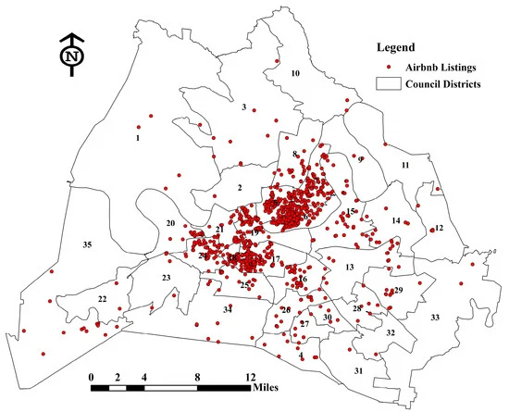
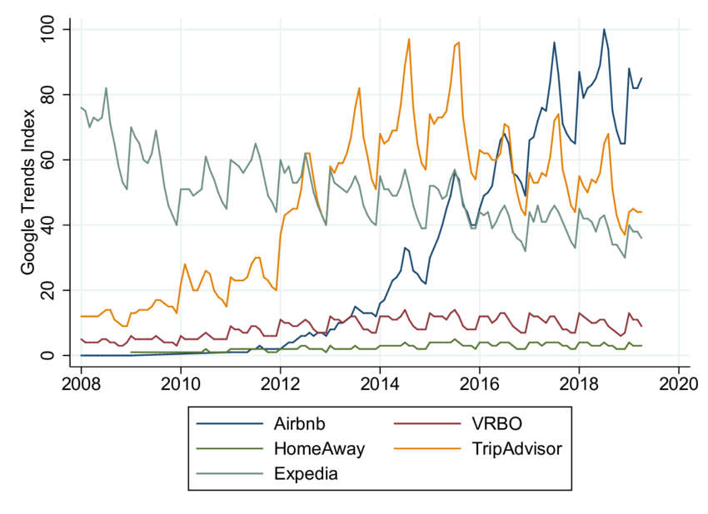
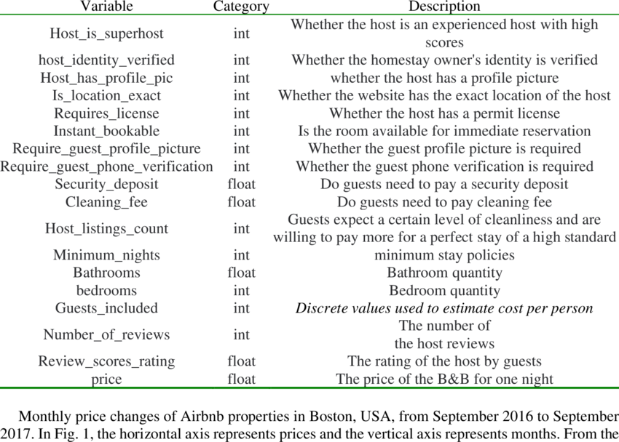

Literature Review
“Key Factors Affecting the Price of Airbnb Listings: A Geographically Weighted Approach”
by Zhihua Zhang, Rachel J. C. Chen, Lee D. Han, and Lu Yang (2017)
“The Sharing Economy and Housing Affordability: Evidence from Airbnb”
by Barron, Kung, and Proserpio (2018)
“Predicting Airbnb Listing Price with Different models”
by Haoqian Wang
(2023)
Notes:
, the first paper highlight how proximity to key locations like convention centers significantly raises Airbnb prices in Nashville. Another study by Barron et al. points out that a mere 1% increase in Airbnb listings can notably increase both rents and house prices, especially in zip codes with lower owner-occupancy rates. Moreover, Haoqian Wang's research on predictive models using a Boston dataset reveals that models like Random Forest showed good performance, providing a basis for selecting appropriate predictive techniques in the research

Slide 4
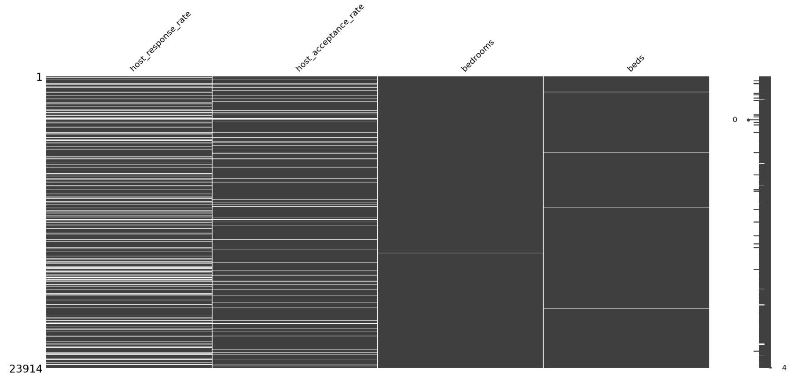
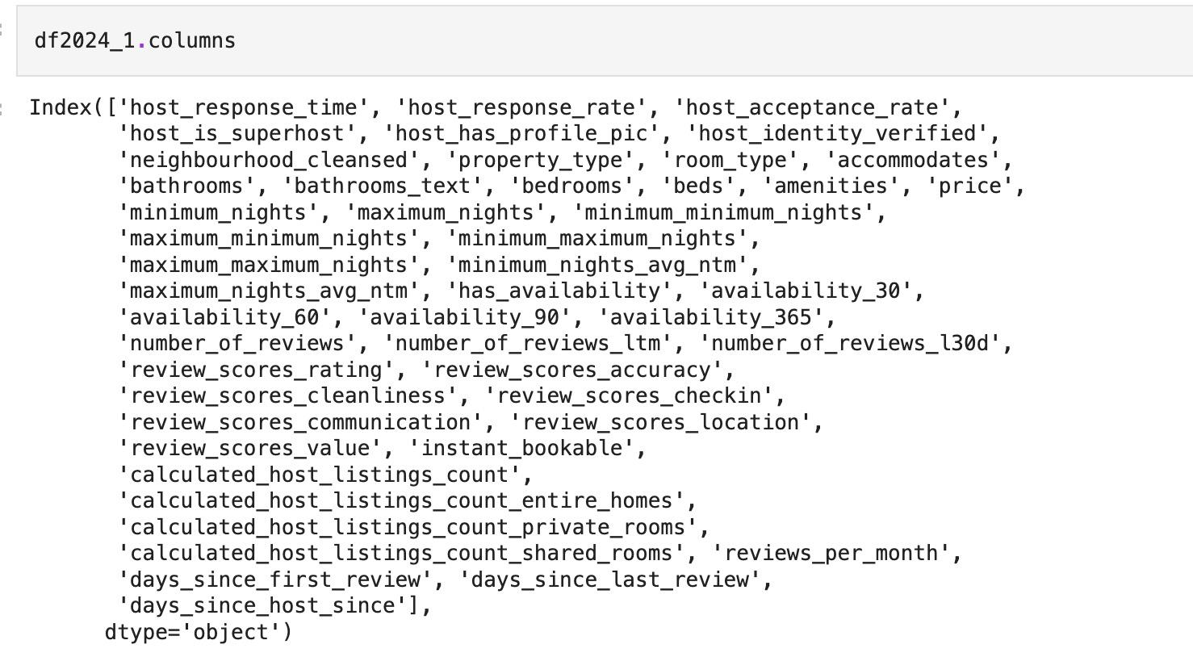
Data Cleaning
Notes:
We isolated numeric columns for correlation analysis and visualized categorical data distributions to understand the diversity of Airbnb listings. To streamline the dataset, we removed irrelevant metadata and managed missing values by deleting columns with substantial missing data and filling in numeric gaps appropriately. We also standardized data types, converting rates to floats and mapping boolean values to true/false. After cleaning, we finalized the dataset by removing any remaining incomplete rows and unnecessary columns, ensuring it was optimized for accurate predictive modeling.

Slide 5
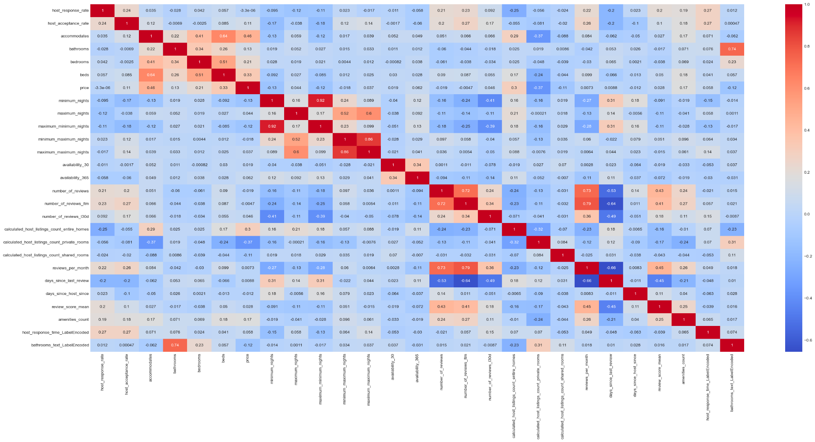
Exploratory Analysis
Correlation map
Significant Predictors of Airbnb Pricing：
host_acceptance_rate
accommodates
number of bathrooms
number of bedrooms
number of beds
Calculated_host_listings_count
amenities_count
Notes:
EDA 我会介绍下通过基本eda 出来的变量后面 pca 可以结合我的说

Slide 6
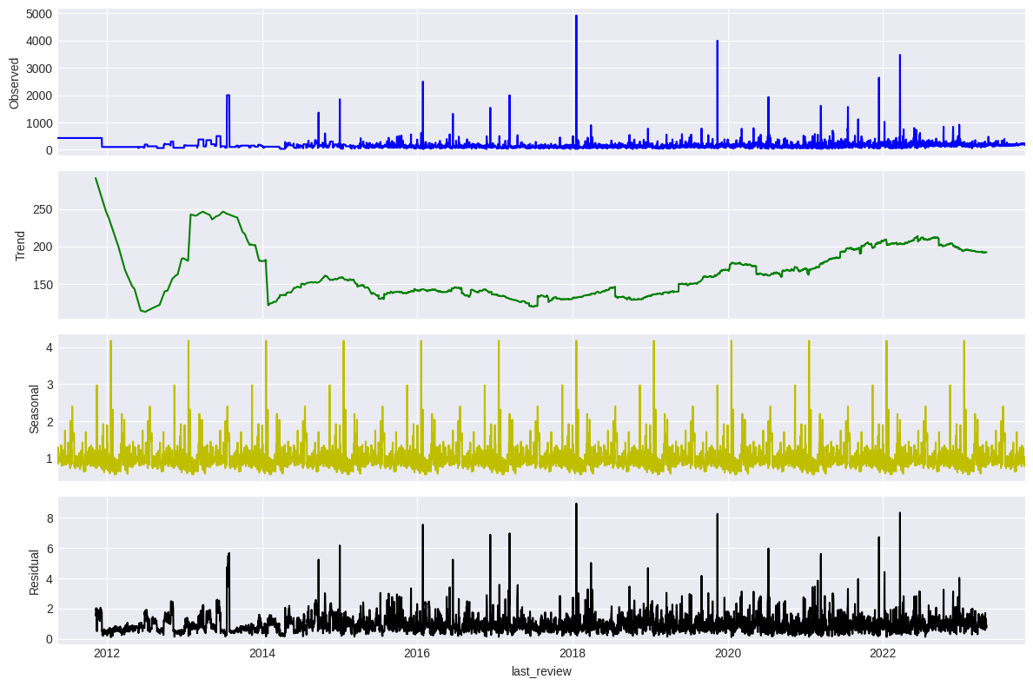
Time Series
This report use time series analysis methods to predict Airbnb price trends over the next 180 days, assisting the platform and hosts make more effective pricing strategies and market decisions.
Notes:
In this report, we employ time series analysis to forecast Airbnb price trends for the next 180 days, aiding both the platform and hosts in optimizing pricing strategies. Our comprehensive analysis from 2012 to now deconstructs the data into trend, seasonal, and residual components, offering insights into the evolution of prices, which initially declined sharply, fluctuated, and then stabilized.

Slide 7
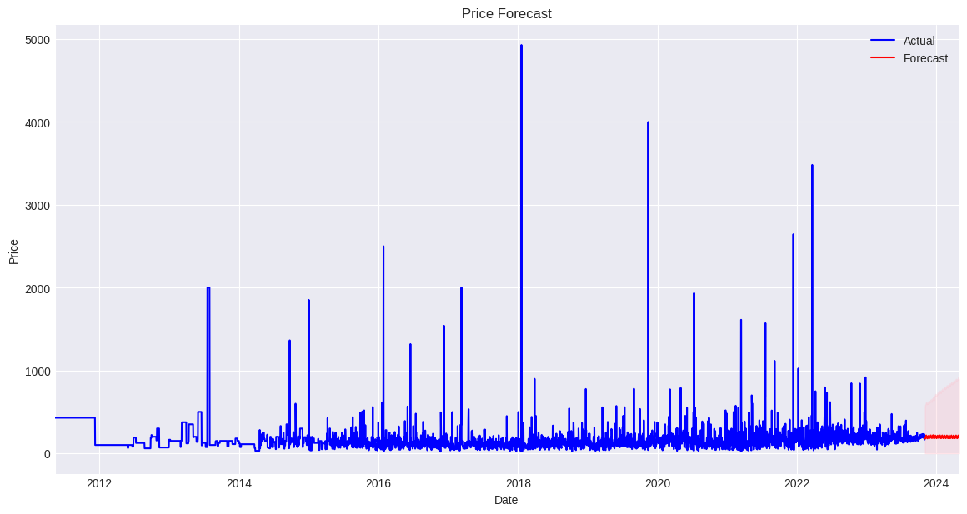
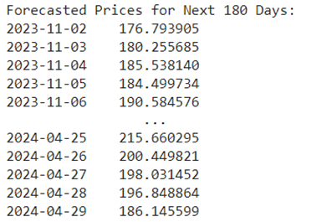
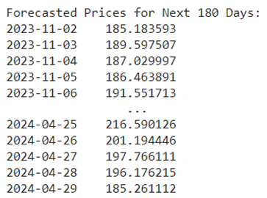
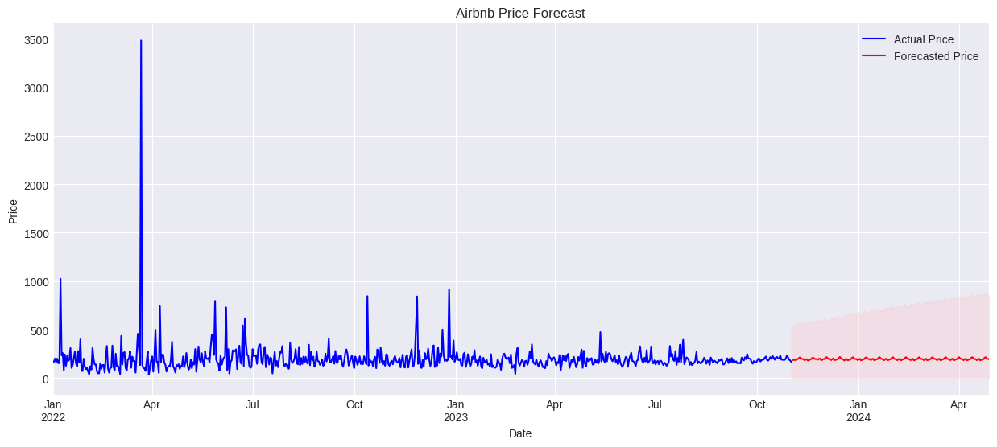
Cont.
We adapted our analysis by conducting separate forecasts: one using the full dataset from 2012 onwards, and another focusing only on data from 2022 onwards. This approach helps us isolate and understand the lingering effects of the COVID-19 pandemic on market dynamics.
Notes:
To address the ongoing impact of COVID-19, we segmented our analysis into two parts: one using the complete dataset from 2012 and another focusing only on data from 2022 onwards. This approach helps us isolate the pandemic's influence on market dynamics, revealing distinct recovery patterns. The analysis of the entire dataset indicates a gradual recovery in the market. At the same time, the more recent data from 2022 onwards suggests a stable market with minimal price fluctuations as it rebounds from the pandemic's effects.

Slide 8
Feature Engineering
Implementation:
Collinearity Reduction:
High collinearity among features can destabilize model estimation. We removed highly collinear variables to simplify our models and reduce the risk of overfitting.
One-Hot Encoding:
Categorical variables such as neighborhoods were transformed using one-hot encoding. This method helps in handling non-numeric data, allowing models to better predict outcomes without assuming ordinal relationships.
Normalization:
We observed the frequency distribution, skewness, and kurtosis of the data, leading us to apply log transformation to the price variable. This adjustment corrects skewness, enhancing model accuracy as many algorithms assume normally distributed data.

Slide 9
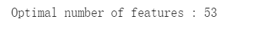
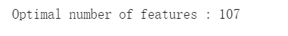
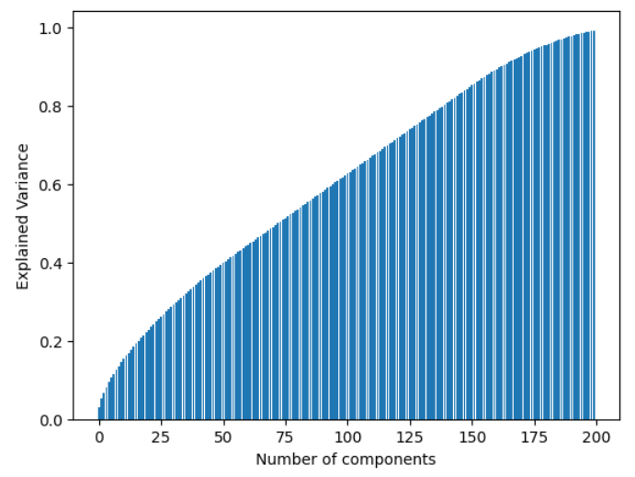
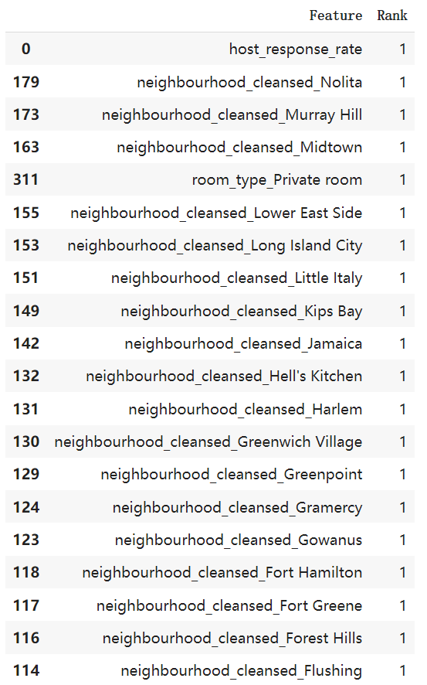
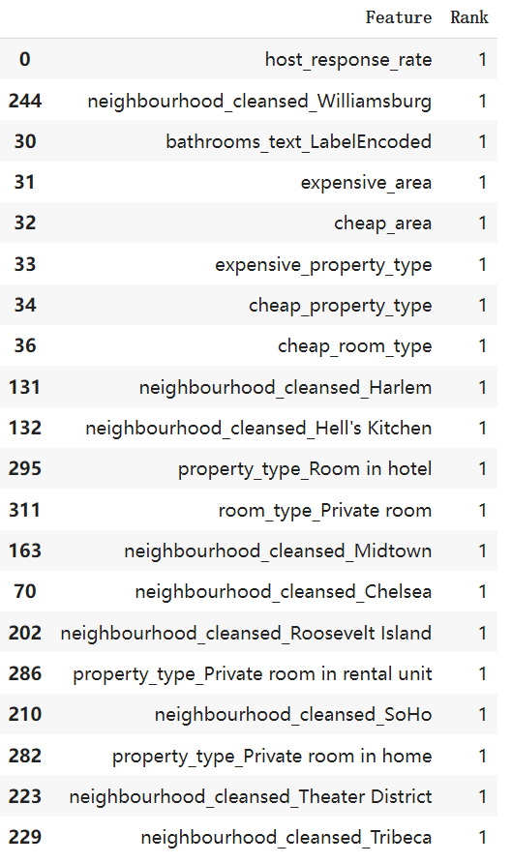
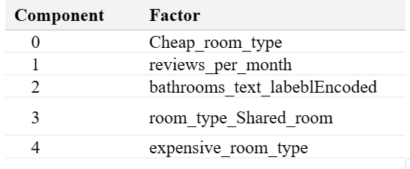
Feature Engineering
Implementation:
Feature Selection:
We use 3 methods:
RFE+XGBoost
RFE+Random Forest
PCA

Slide 10
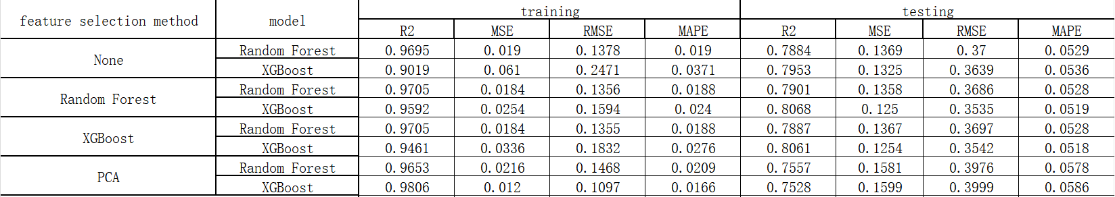
Ensemble Method Training
Experiments and Implementation:
We use 2 models:
1. XGBoost
2. Random Forest
Grid Search Cross-Validation: We utilized grid search with cross-validation to optimize model parameters systematically. This method ensured the selection of the most effective hyperparameters.
Hyperparameter Tuning:
Random Forest: We tuned parameters such as n_estimators, max_depth, and min_samples_split to control model complexity and improve generalization.
XGBoost: Parameters like max_depth and eta were adjusted to optimize training speed and model performance.
Results:

Slide 11
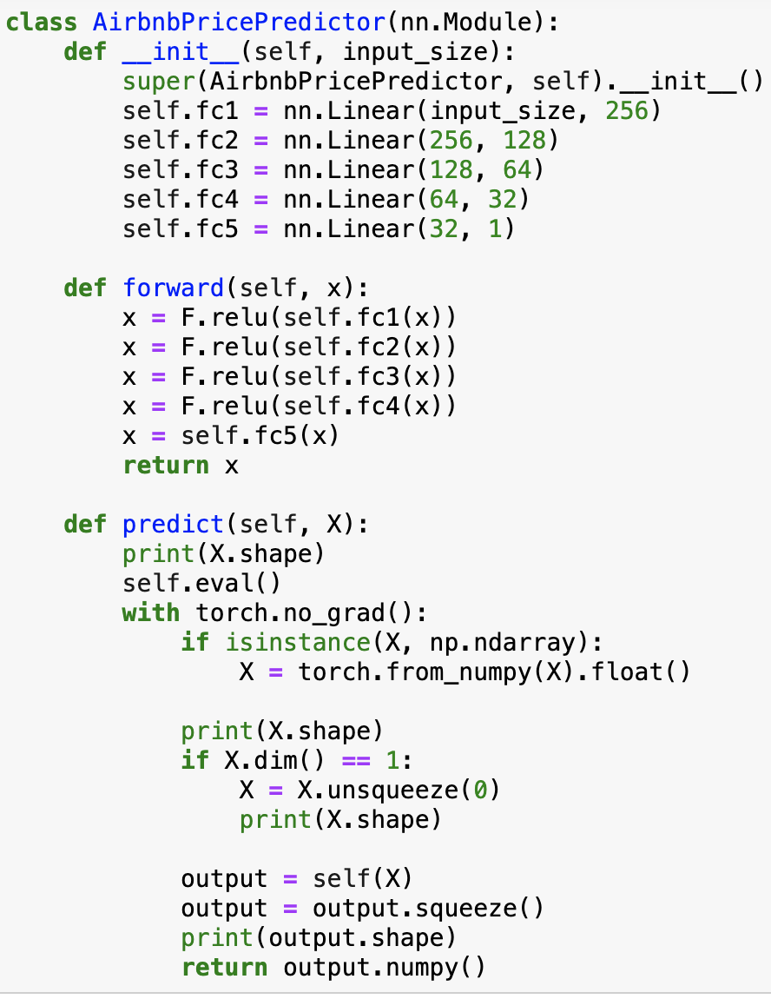
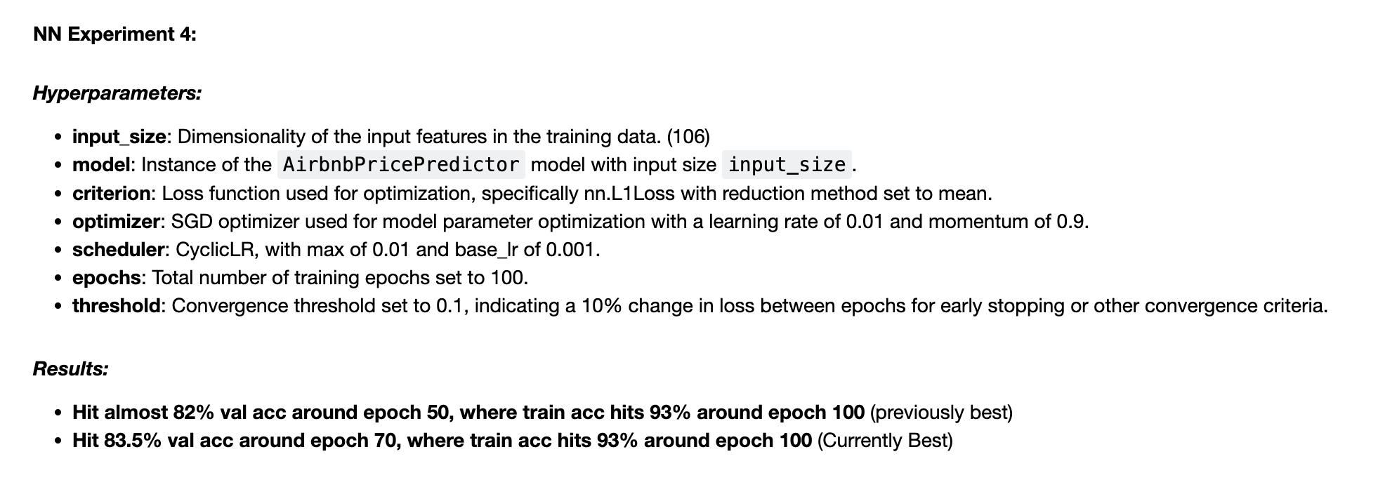
Neural Network Training
Experiments and Implementation:
We use 4 models:
1. Basic 5 layers
2. Basic 5 layers with Dropout
3. Basic 5 layers with Batch Normalization
4. Advanced Model with 9 layers

Slide 12
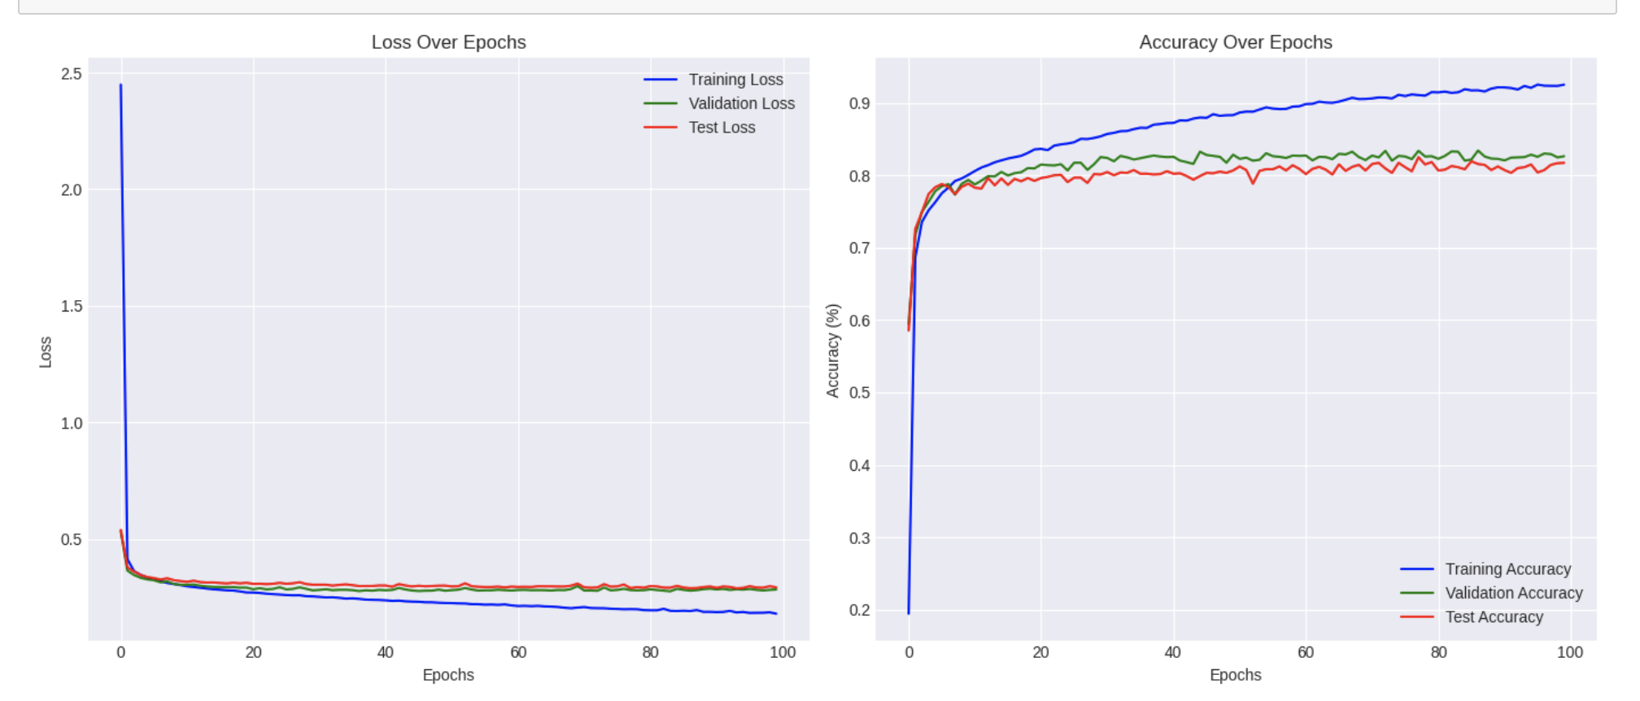
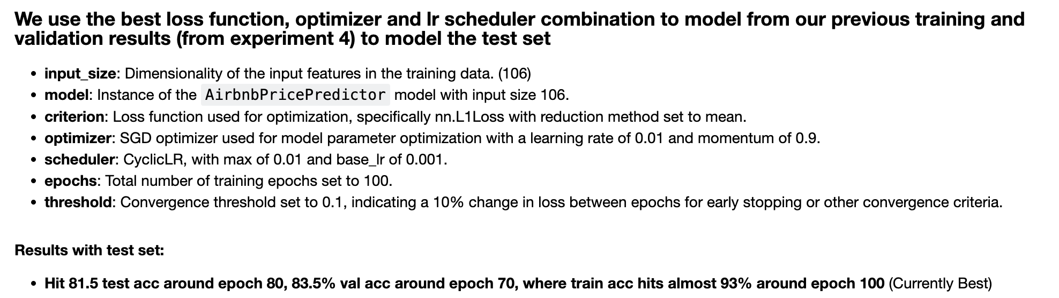
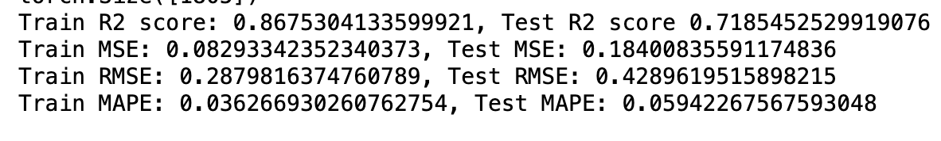
Neural Network Training
Results:

Slide 13
Limitation
Dataset Utilization:
The same month's dataset was used for training, validation, and testing phases in neural network training.
Model Performance
The basic 5-layer model with SGD parameters showed slightly superior performance, achieving an average validation set accuracy of around 81%.
Dataset Limitations
The dataset was relatively small, yet it contained comprehensive Airbnb room information and pricing data available.
Notes:
In our neural network training, we utilized the same month’s dataset for training, validation, and testing, where the basic 5-layer model with SGD parameters slightly outperformed others, achieving an average validation accuracy of around 81%. The model training could perform better if we have a larger available dataset.
Despite the dataset's limited size, the results are promising and suggest the models' applicability to other urban areas, provided that relevant data like crime rates, educational quality, and environmental factors are incorporated to adapt the models for local conditions in cities like Philadelphia or Boston.

Slide 14
Recommendations
Host should consider adjusting their pricing strategies based on the season, local events, and the quality of reviews and ratings to stay competitive.
Policy Makers could use these insights to understand the impact of short-term rental platforms on local housing markets, potentially guiding regulations and housing policies.
Future Research could integrate additional data sources such as economic indicators or global event impacts to refine predictions and address broader market dynamics.

Slide 15
Thank You !

